Slide 1
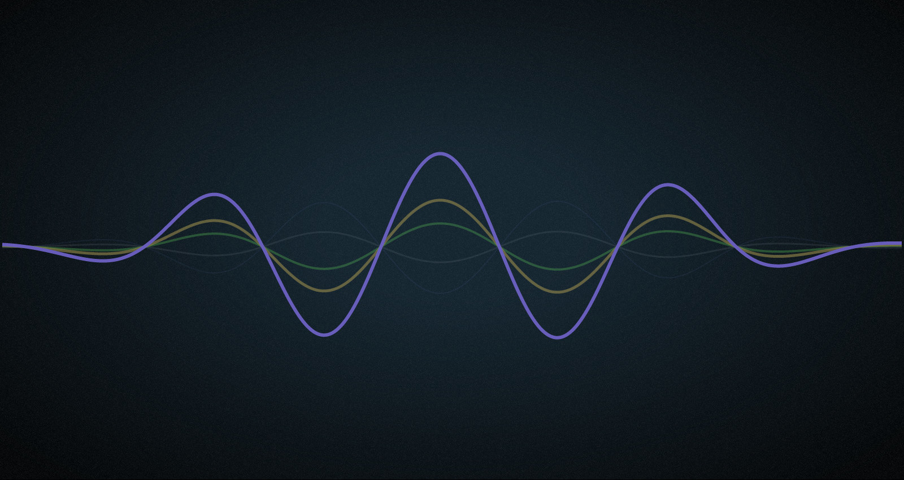
MUSIC GENRE CLASSIFICATION
Saurabh Parkar | Vaibhav Saraf | Sanjan Vijayakumar

Slide 2
CONTENTS
Introduction
Dataset
Feature Definitions
Pre-processing
Classical/ Neural Network Models
Classical/ Neural Network model Metrics
Future Scope
Conclusion
References

Slide 3
INTRODUCTION AND MOTIVATION
Genre classification is an important task for any music streaming/purchasing service as it helps to instantly classify songs in any given playlist or library by genre. It streamlines the user experience by allowing them to sort through music based on their genre preference and find music similar to the genres they like.
In this project, we plan to build models to classify audio clips into one of the 8 different music genres using various machine learning approaches.

Slide 4
DATASET
Our library of audio samples was taken from the Free Music Archive (FMA) Dataset.
8000 songs samples from 8 genres; 30s each.
Dataset is packaged with other preprocessing features such as track information, genres, and features extracted using librosa audio libraries.
It consists of three csv files - features.csv, tracks.csv, genres.csv
Link to dataset - ​https://github.com/mdeff/fma

Slide 5
FEATURE DEFINITIONS
Features are hard to identify using audio alone.
Previous studies on music genre classification involves building models using a comprehensive set of features like rhythm, pitch and temporal structure.
In recent times spectrograms have become a popular feature in Audio Information retrieval techniques such as speech recognition and audio similarity. These Spectrograms can be considered as images and used to train convolutional neural networks (CNNs).

Slide 6
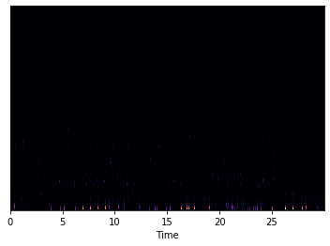
PRE-PROCESSING
Fourier Transform uses a signal in the time domain as input, and outputs its decomposition into frequencies.
A signal in the frequency domain requires much less computational space for storage.

Slide 7
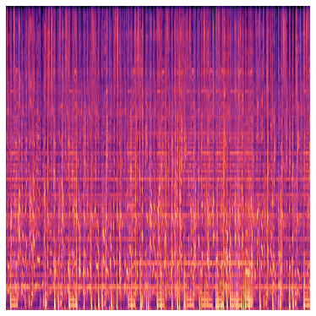
PRE-PROCESSING
Next we transform both the y-axis (frequency) to log scale, the “color” axis (amplitude) to Decibels, which is basically the log scale of amplitudes and Hertz scale to Mel scale.

Slide 8
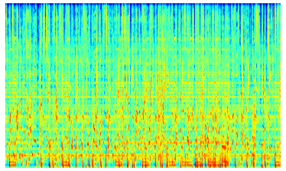
PRE-PROCESSING
Using a different colormap -

Slide 9
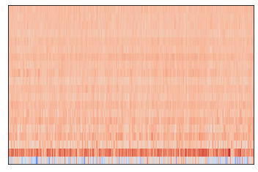
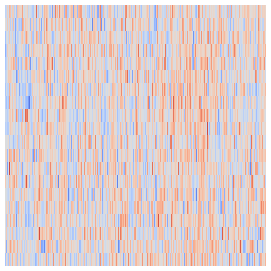
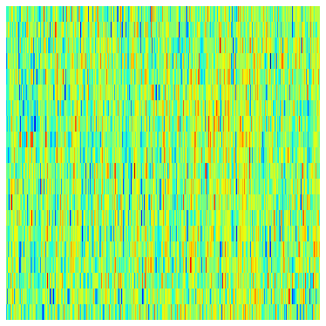
MFCC SPECTROGRAMS

Slide 10
MODELS
This work aims to provide a comparative study between -
1) the deep learning based models which only require the spectrogram as input and,
2) the traditional machine learning classifiers trained on the csv files.

Slide 11
CLASSICAL MODELS
The Classical Models approach makes predictions based on the csv features like MFCC frequency, Tonnetz, Zero crossing rate
Each track was divided into 12 equal parts and aggregates like mean, median, mode, etc of all the features were calculated for each of those 12 parts
LightGBM and XGBoost are both gradient boosting frameworks that use decision tree based learning algorithms
The LightGBM model uses XGBoost as a baseline and outperforms it in training speed and the dataset sizes it can handle

Slide 12
CLASSICAL MODELS METRICS
Sr. No | Models | Accuracy | Precision | Recall
1 | LDA | 55.75% | 0.56 | 0.56
2 | XGBoost | 57.41% | 0.57 | 0.57
3 | Logistic Regression (L1 regularised) | 57.45% | 0.56 | 0.57
4 | SVM | 62% | 0.62 | 0.62
5 | LGBM | 64% | 0.63 | 0.63

Slide 13
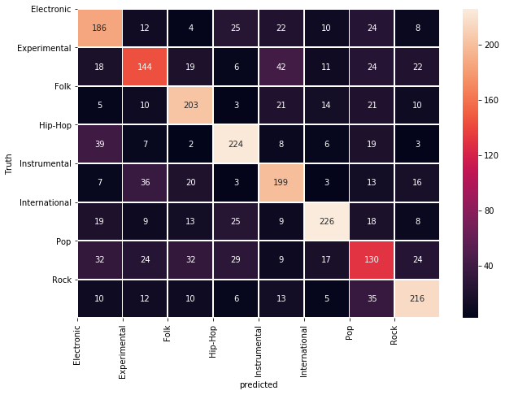
Confusion Matrix (LGBM)

Slide 14
NEURAL NETWORKS APPROACH
The CNN approach helps to make predictions based on the visual features extracted from the spectrograms.
The RNN approach makes predictions by summarizing the extracted audio features along the temporal component
Combining RNN with CNN (C-RNN) can help to introduce time sequential information to the features extracted from the spectrograms.

Slide 15
SPECTROGRAM MODELS METRICS
Sr. No | Models | Accuracy | Precision | Recall
1 | CNN | 52.87% | 0.52 | 0.53
2 | LSTM | 50.69% | 0.51 | 0.48
3 | C-RNN | 55.48% | 0.55 | 0.55

Slide 16
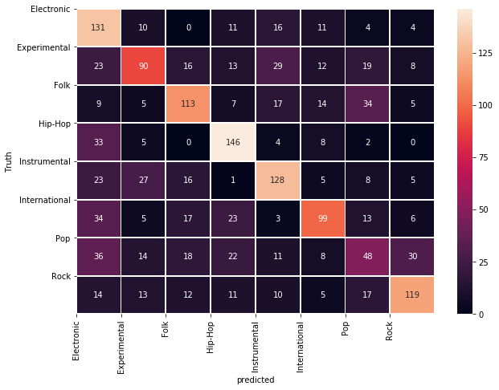
Confusion Matrix (C-RNN)

Slide 17
FUTURE SCOPE
Improving the accuracy on the present dataset by fine tuning the models and including metadata features
Working with MFCC values might yield a better accuracy
Extending the models to work with FMA Full dataset which contains 100,000+ untrimmed audio clips with 161 unbalanced genres.

Slide 18
CONCLUSION
The objective of our project was to accurately classify music audio samples to their correct genre. We achieved over 55% accuracy in several models with 64% being the highest.
Accuracy can be increased by using more accurate samples of each genre
At the same time, as the number of genres increase, correctly classifying genres for a 30s audio clip becomes a difficult task.

Slide 19
REFERENCES
Tutorial on MFCC:
http://practicalcryptography.com/miscellaneous/machine-learning/guide-mel-frequency-c epstral-coefficients-mfccs/
Papers on Music Genre Classification:
http://cs229.stanford.edu/proj2018/report/53.pdf
http://www.cs.cmu.edu/~yh/files/GCfA.pdf
http://www.eecg.utoronto.ca/~jayar/mie324/musicgenre.pdf
https://www.researchgate.net/publication/324218667_Music_Genre_Classification_using _Machine_Learning_Techniques/

Slide 20
THANK YOU!

